Slide 1

Design and Analysis of Algorithms
Instructor: Muhammad Arif Shah

Slide 2
Objective of This Course
Major objectives of this course is:
Design and analysis of modern algorithms
Different variants
Accuracy
Efficiency
Comparing efficiencies
Motivation thinking new algorithms
Advanced designing techniques
Real world problems will be taken as examples
To create feelings about usefulness of this course

Slide 3
Expected Results
On successful completion, students will be able to
Argue and prove correctness of algorithms
Derive and solve mathematical models of problems
Reasoning when an algorithm calls certain approach
Analyze average and worst-case running times
Integrating approaches in dynamic and greedy algos.
Use of graph theory in problems solving
Advanced topics such as
  Computational geometry, number theory etc.
Several other algorithms such as
  String matching, NP completeness, approximate algorithms etc.

Slide 4
Lecture No 1
Introduction
(What, Why and Where Algorithms . . .)

Slide 5
Today Covered
In this lecture we will cover the following
What is Algorithm?
Designing Techniques
Model of Computation
Importance of algorithms
2-D maxima: An example
Conclusion

Slide 6
What is Algorithm?
A computer algorithm is a detailed step-by-step method for solving a problem by using a computer.
An algorithm is a sequence of unambiguous instructions for solving a problem in a finite amount of time.
An algorithm is thus a sequence of computational steps that transform the input into output
An Algorithm is well defined computational procedure that takes some value, or set of values, as input and produces some value, or set of values as output.
More generally, an Algorithm is any well defined computational procedure that takes collection of elements as input and produces a collection of elements as output.
Algorithm
Input
output

Slide 7
Why to study Algorithm?
Theoretical Importance
  The core of Computer Science
Practical Importance
  A practitioner’s toolkit of known algorithms
  Framework for designing and analyzing algorithms for new problems
A good understanding of algorithm design is a central element to a good understanding of computer science and computer programming.

Slide 8
Requirements of an Algorithm?
Finiteness
  terminates after finite number of steps
Definiteness
  rigorously and unambiguously specified
Input
  valid inputs are clearly specified
Output
  can be proved to produce the correct output given a valid input
Effectiveness
  steps are sufficiently simple and basic

Slide 9
Algorithm and Programming?
A good understanding of algorithms is essential for programming.
However, unlike a program, an algorithm is a mathematical entity.
Algorithm is independent of a specific programming language, machine, or compiler.
Algorithm design is about mathematical theory behind the design of good programs.
This course is all about how to design good algorithms
We will mathematically prove whether algorithm1 is better/worse than algorithm2

Slide 10
Popular Algorithms, Factors of Dependence
Most basic and popular algorithms are
  Sorting algorithms
  Searching algorithms
Which algorithm is best?
Mainly, it depends upon various factors, for example in case of sorting
  The number of items to be sorted
  The extent to which the items are already sorted
  Possible restrictions on the item values
  The kind of storage device to be used etc.

Slide 11
Course Outline
This course will consist of four major parts
Mathematical Tools: necessary for the analysis of algorithms. This will focus on asymptotic, summations, and recurrences.
Sorting: This will focus on different strategies for sorting, and using this as a case-study in different techniques for designing and analyzing algorithms
Collection of various algorithmic problems and solution techniques like Dynamic programming, greedy strategy, graphs etc.
  Introduction to the theory of NP-completeness. NP-complete problems are those for which no efficient algorithms are known, but no one knows for sure whether efficient solutions might exist.

Slide 12
Important Designing Techniques
Brute Force
  Straightforward, naive approach
  Mostly expensive
Divide-and-Conquer
  Divide into smaller sub-problems
Iterative Improvement
  Improve one change at a time
Decrease-and-Conquer
  Decrease instance size
Transform-and-Conquer
  Modify problem first and then solve it
Space and Time Tradeoffs
  Use more space now to save time later

Slide 13
Model of Computation (Assumptions)
In order to design good algorithms, we must first agree on the criterion for measuring algorithms
The emphasis is on the design of efficient algorithms
We will measure algorithms in terms of the amount of computation resources that the algorithm requires:
  Running Time
  Memory
We want the analysis to be as independent as possible of the variations in machine, operating system, compiler, or programming language
Unlike programs, algorithms are to be understood primarily by people and not machines
This gives us quite a bit of flexibility in how we present our algorithms, and many low-level details may be omitted

Slide 14
Model of Computation (Assumptions)
A RAM is assumed to be an idealized machine
  Infinitely large random-access memory
  Instructions execute sequentially
Every instruction is in fact a basic operation on two values in the machines memory which takes unit time.
These might be characters or integers.
Example of basic operations include
  Assigning a value to a variable
  Arithmetic operation (+, - , × , /) on integers
  Performing any comparison e.g. a < b
  Boolean operations
  Accessing an element of an array e.g. A[10].

Slide 15
Model of Computation (Assumptions)
RAM
  Infinite memory
  Single processor
  Generally two operands in each operation

Slide 16
Model of Computation
Basic operations in C++ that are assumed to take up same amount of CPU time.
  x=y;
  z = a + b; z = a-b;
  z = a * b; z = z/b;
  z = W[10];
  (z <= y)
1 μ sec
2 μ sec
2 μ sec

Slide 17
Summary : Computational Model
Analysis will be performed with respect to this computational model for comparison of algorithms
We will give asymptotic analysis not detailed comparison i.e. for large inputs
We will use generic uniprocessor random-access machine (RAM) in analysis
  All memory equally expensive to access
  No concurrent operations
  All reasonable instructions take unit time, except, of course, function calls

Slide 18
Example : 2-Dimensional Maxima
Let us take an example that illustrates how we analyze algorithms.
  Suppose you want to buy a car
  You want to pick the fastest car
  But fast cars are expensive; and you want the cheapest
  You cannot decide, which is more important: speed or price
  Definitely, we do not want a car if there is another that is both faster and cheaper

Slide 19
Example : 2-Dimensional Maxima
We say that the fast, cheap car dominates the slow, expensive car relative to your selection criteria.
So, given a collection of cars, we want to list those cars that are not dominated by any other.
Here is how we might model this as a formal problem.

Slide 20
Example : 2-Dimensional Maxima
Let a point p in 2-dimensional space be given by its integer coordinates, p = (p.x, p.y)
A point p is said to be dominated by point q if p.x ≤ q.x and p.y ≤ q.y
Given a set of n points, P= {p1, p2, …, pn} in 2-dimensional space, a point is said to be maximal if it is not dominated by any other point in P.

Slide 21
Example : 2-Dimensional Maxima
The car selection problem can be modeled this way:
  For each car we associate (x, y) pair where
    x is the speed of the car and
    y is the negation of the price (indicate the saving)
  High y value means a cheap car and Low y value means expensive car
  Think of y as the money left in your pocket after you have paid for the car
  Maximal points correspond to the fastest and cheapest cars.

Slide 22
Example : 2-Dimensional Maxima
Now from Algorithmic point of view
2-dimensional Maxima:
  Given a set of points P= {p1, p2, …, pn} in 2-dimensional space
  Output the set of maximal points of P, i.e. those points pi such that pi is not dominated by any other point of P.

Slide 23
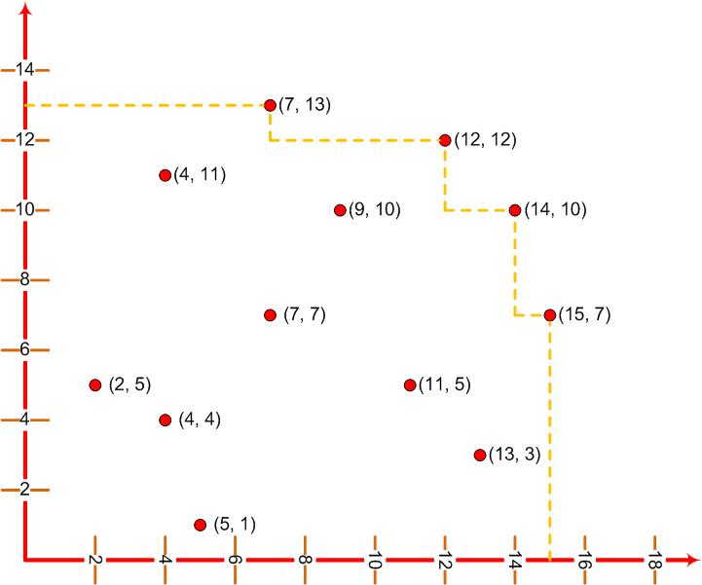
Example : 2-Dimensional Maxima

Slide 24
Example : 2-Dimensional Maxima
Our description of the problem is at a fairly mathematical level
We have intentionally not discussed how the points were represented
We have not discussed any input or output formats
We have avoided programming and other software issues

Slide 25
Conclusion
What, Why and Where Algorithms?
Designing Techniques
Model of computations
  Major assumptions at design and analysis level
Discussed importance of algorithms
  In almost all areas of computer science and engineering

